Slide 1
Code Review and Security Audit in Private Cloud
@karfianto
UKP4

Slide 2
About Me
UPN alumnus
civil cervant
sysadmin
system analyst
app tester

Slide 3
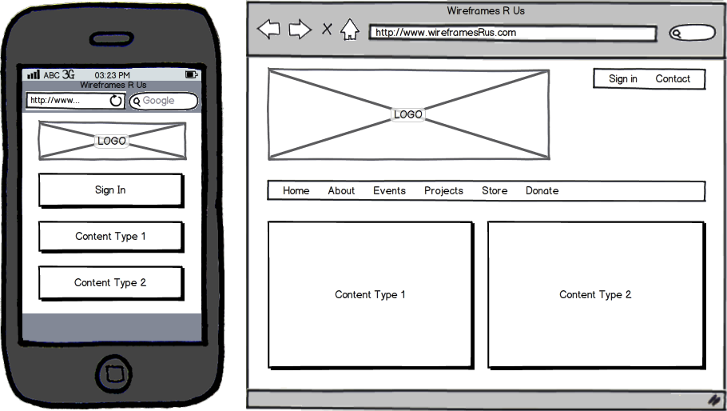
Things I Like
foss
website optimization
system security
wireframing

Slide 4




Managed Projects
data.id

Slide 5
Problems in App Development
design
functionality test
security test
maintenance

Slide 6
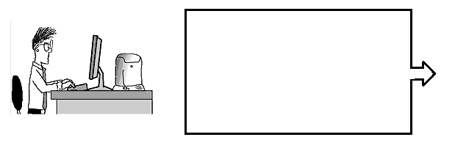
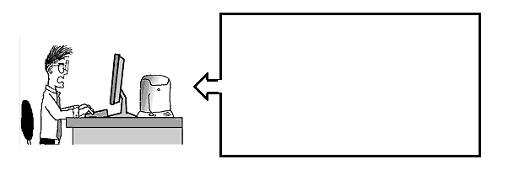
Problem: Maintenance
From: sysadmin
Hi Developers,
There’s a bug in your app
From: postmaster
Error
User not found dude@expert.com

Slide 7
Security Test
Blackbox
Greybox
Whitebox (Code Review)

Slide 8
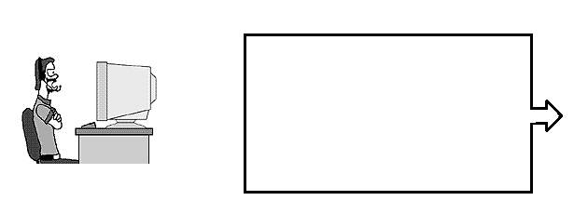

Problem: Access to Source Code
From: Developers
Hi sysadmin,
We found some bugs in the app, we will patch soon
From: Sysadmin
Hi developer,
Username: root
Password: 123456

Slide 9
Problem: No Changes History
From: Developers
Hi sysadmin,
We found some bugs in the app, we will patch soon
From: Sysadmin
Hi developer,
Please send me the changed php files..

Slide 10
500 Internal Server Error
From: Sysadmin
Hi developer,
There’s another error after patching. Please roll them back ..!!

Slide 11
Let’s Make Our Job Easier
Create source code repository
Use versioning
Control user access to the code
No access to production servers

Slide 12





Free Source Code Hosting

Slide 13
Make It Private
security
availability
policy compliance (e.g. iso27001)

Slide 14
...and Flexible
Using Cloud Infrastructure
Flexible Resource
Cloning
High Availability
Snapshot and Restore

Slide 15
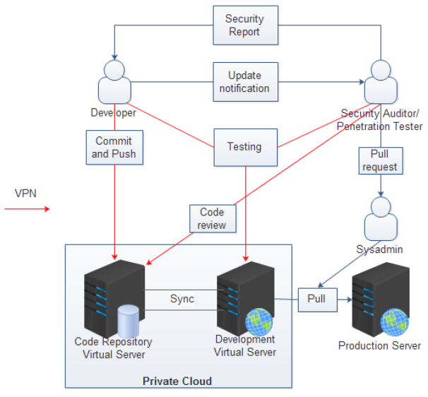
Model

Slide 16
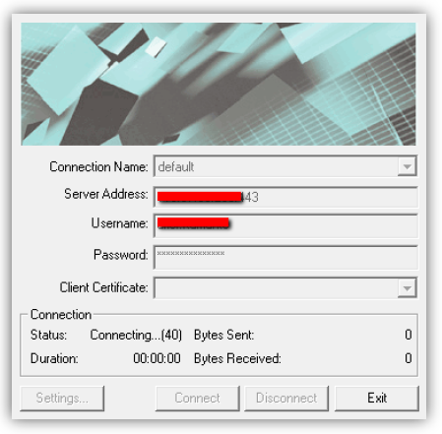
How These Stuffs Work
VPN Tunneling

Slide 17
Related Tools
Git : a version control system
Gitweb : the git web interface
Gitosis : repository access control
VPN & SSH : tunneled access

Slide 18
Creating a Repository
root@revision-control ~# ./addrepo.sh
Please enter repository name and description
Name :sample-app2
Description :Sample application 2.0
Creating a repository...
Initialized empty Git repository in /srv/repos/git/sample-app2/.git/
# On branch master
#
# Initial commit
#
nothing to commit (create/copy files and use "git add" to track)
Cloning into bare repository repositories/sample-app2.git...
done.
warning: You appear to have cloned an empty repository.
[Done]

Slide 19
Gitosis Config
Copy the public key to server
Then edit gitosis.conf..
[group sample-app2]
writable = sample-app2
members = intruder@LENOVOY460 John@Doe.PC

Slide 20
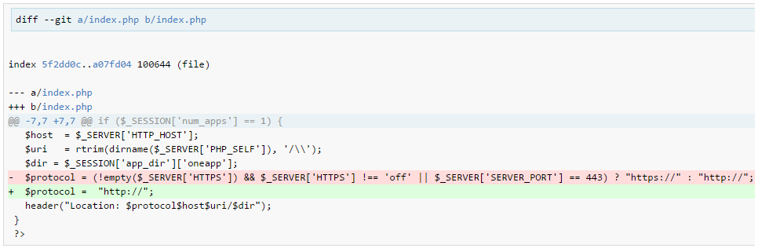
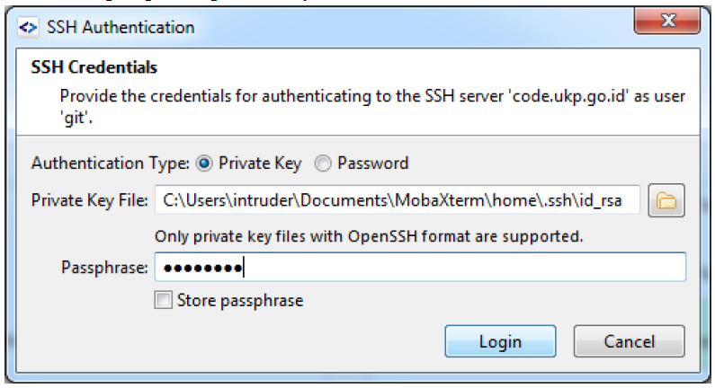
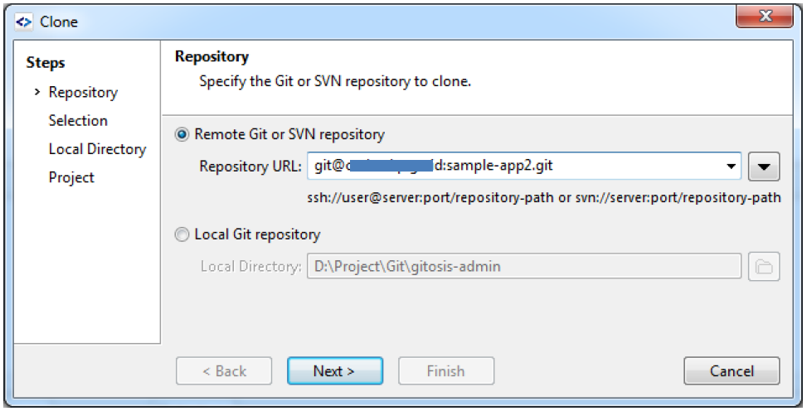
Clone and Review

Slide 21
Thank You

